Slide 1
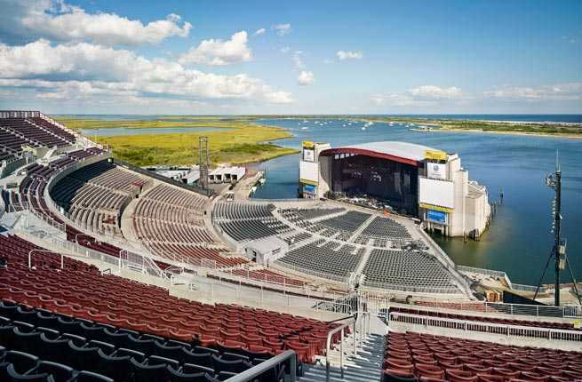
Music Amphitheatres
Notes:
Pratim

Slide 2
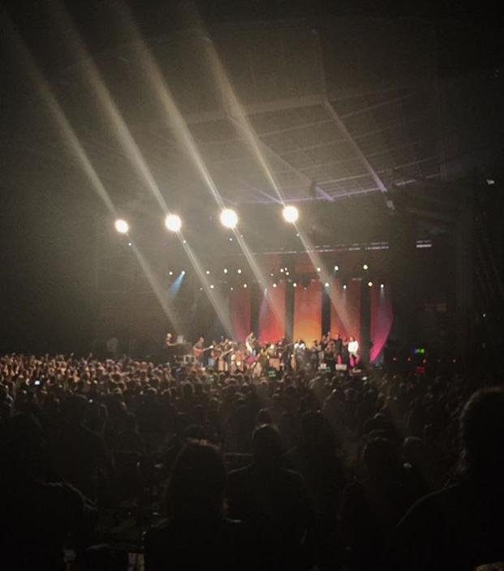
Our Idea
Entertainment Area
Outdoor venues for concerts, plays, etc.
Food trucks and concession lane, outside of the ampitheatre
Parking areas in the middle of the island
Bridge leading to island
Notes:
Pratim

Slide 3
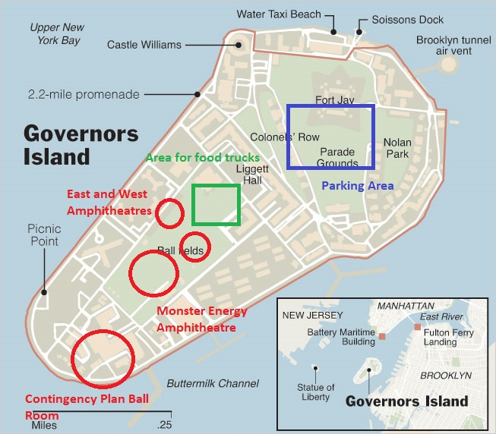
Notes:
Pratim

Slide 4

Monster Energy Amphitheatre
Largest amphitheatre:
Outdoor venue
9,000 concertgoers
Sponsored by Monster Energy
Big and small name entertainers
Cost to build: $20 million
Cost to maintain: $2.5 million per year
Total over 7 years is $37.5 million
Notes:
Pratim

Slide 5
East and West Amphitheatres
2 smaller amphitheatres:
Outdoor venues
2,000 concertgoers each
Big and small name entertainers
Cost to build: $7.5 million each
Cost to maintain: $2 million per year
Total over 7 years is $29 million
Notes:
Sam

Slide 6
Rationale - Single Purpose
Single focal point
Additional features coincide with central idea
Consistent concert-theme
Allows for multiple revenue streams
Overlapping maintenance responsibilities
Easier to maintain
Notes:
Sam

Slide 7
Budget
With an overall budget of $100 million, we’ll divide it as follows:
$20 million to build the main amphitheatre
$15 million to build the 2 smaller amphitheatres
$31.5 million to maintain the amphitheatres for 7 years
$13.4 million for security over 7 years
$5 million for janitorial crew and sanitation workers over 7 years
$7.6 million for contingency plan of ballroom
$7.5 million for negotiating artist payments
Notes:
Justin

Slide 8
Timeline
3 years to complete construction (December 31, 2021)
1 year for the Monster Energy Amphitheatre
6 months for each of the smaller amphitheatre
Ballrooms (if amphitheatre construction fails)
2 ballrooms would take about 3-4 months to construct
Using pervious buildings
7 years to bring in $50 million after construction is completed (December 31, 2028)
Notes:
Justin

Slide 9
Expected Outcomes
Create an entertainment center that can generate revenue
Build 3 Amphitheatres that can host 13,000 total people
Operate 9 out of 12 months per year
Attract food trucks to serve concert-goers
Earn revenue from ticket sales, food trucks and concessions
Notes:
Tarquin

Slide 10
Key Milestones
Start of construction of Monster Energy Amphitheatre
Start of construction of East and West Amphitheatre
Halfway point of construction of Monster Energy Amphitheatre
Halfway point of construction of East and West Amphitheatre
Completion of construction of Monster Energy Amphitheater
Completion of construction of East and West Amphitheatre
Target date of first concerts
End of first season of concerts
Notes:
Tarquin

Slide 11
Revenue - Tickets
$300,000/week (13 weeks) from “big name” artists
$130,000/week (26 weeks) from lesser known artists
$50,000/week from the smaller amphitheatres
~$64,600,000 in revenue from ticket sales
Notes:
Liam

Slide 12
Revenue - Rent & Sponsorship
Food trucks and naming rights
$150/week from each of 10 food trucks
$10 million from Monster Energy for naming rights
~$10,400,000 in revenue in 7 years
Notes:
Liam

Slide 13
Revenue - Parking
Bridge to the island
$20 for each car
~$4,700,000 in revenue after 7 years
Notes:
Liam

Slide 14
Challenges
Finishing construction on time:
1 Large and 2 Small amphitheatres
Clearing land/unused space and buildings
Renovating and using already existing buildings
Attracting artists to perform
Building reputation
Busy Schedules
Selling merchandise
Consumers need reason to buy (Reputation)
Notes:
Brandon

Slide 15
Contingencies
Possible reasons:
Construction on amphitheatre takes longer than expected
Some part of the amphitheatre becomes damaged and needs to be shut down for repairs
Contingency plan:
Renovate two of the buildings already on the island into ballrooms in order to host large scale indoor events such as weddings and dances
The cost of this would be $7.6 million per ball room which we have in our budget
Revenue from the ballroom will be $5,000 each time to rent
Assuming we rent it 4 times a week, we will make $1.04 million per year if we need it
In addition we have $7.5 million left in the budget
Notes:
Brandon

Slide 16
Conclusion
3 amphitheatres
4 main revenue streams:
Tickets
Parking
Rent
Sponsorship
Total amount spent: $92.5 million
Revenue recovered through 7 years: $79.7 million
Notes:
Brandon

